Slide 1
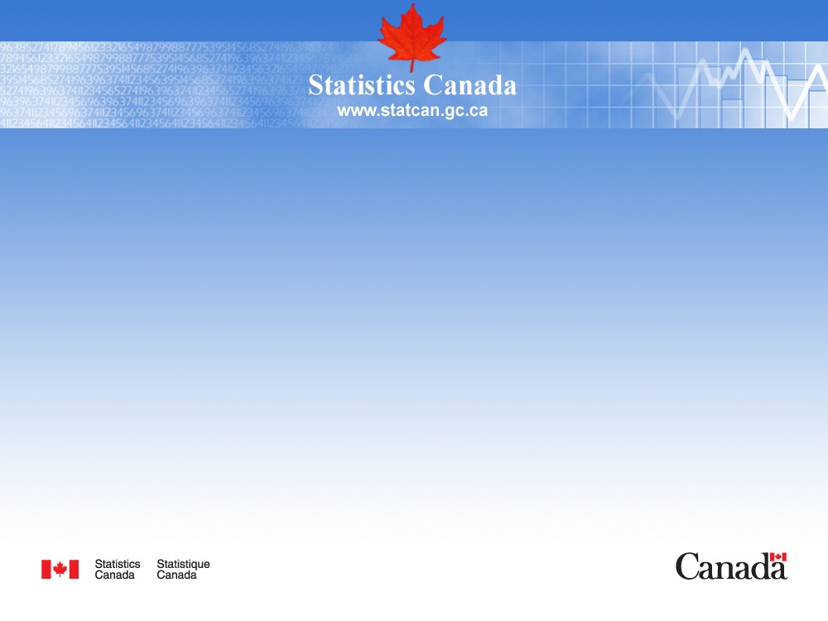
Overview of the Canadian Energy Flow Account
September 2013

Slide 2
Overview
How the Canadian Energy Flow Account is compiled
  control totals and our account structure
  data sources used (consumption per industry)
  compilation method
  how we fill the gaps when data is missing
  quality control
  challenges

Slide 3
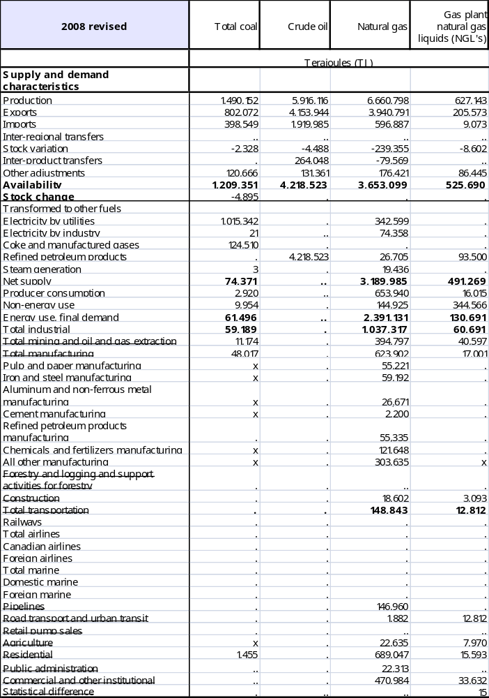
Official Canadian consumption
Annual Report on Energy Supply and Demand (RESD)
Energy balance table covers:
more than 20 fuels
  refined petroleum products and electricity types are detailed
more than 40 supply-demand
  production, trade and inter-regional transfers are listed.
  energy use consumption by sector is shown.
  fuel conversion, producer consumption and non-energy use are isolated.
Net availability is our control total TJ available for consumption = “Availability – Stock change”

Slide 4
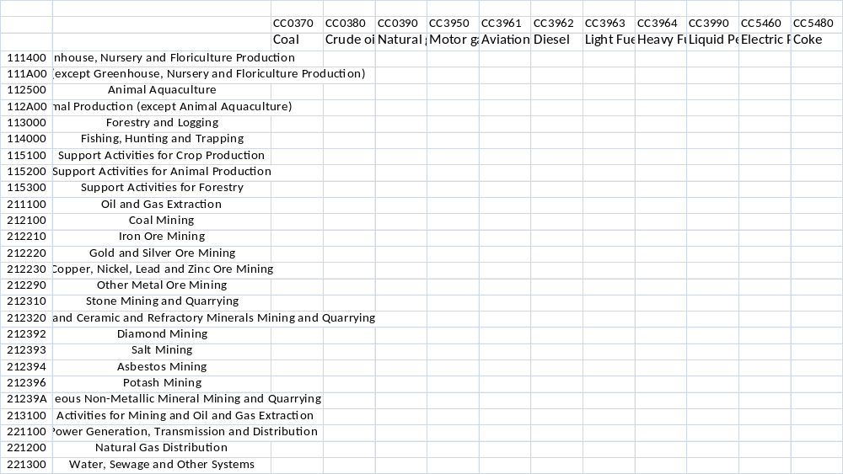
Canadian Energy Flow Account – energy use and non-energy use tables
Fuel types (11)
share same classifications as IO accounts.
detail 11 commodities (fuel types).
compiled at the most detailed industry level.
focus on energy consumption and not supply.
allow linkage between energy flow and economic accounts.
Industries (300) +
household (2)

Slide 5
Discrepancies between our starting point and our final output
Energy Supply & Demand table does not give enough industry detail.
Non-energy, producer consumption and energy conversion amounts are not reported in the industries where it happened.
Fuels are not reported at the same level of detail.
Energy supply & demand | Energy flow account
Total mining and oil and gas extraction | 14 industries
Energy supply & demand |  | Energy flow account
Petroleum Coke | Coke | Coke

Slide 6
Energy Account data sources
Manufacturing sector
Industrial consumption of energy survey
  terajoules (TJ) unit and NAICS classification
  non-energy and energy consumption
  coal, natural gas, electricity, HFO, LPG and coke
Petroleum report (provincial $/litre) and provincial IO expenditure
  derive number of litres bought and transform it into TJ
  diesel, motor gasoline and light fuel oil
~ 20% of total energy consumption

Slide 7
Energy Account data sources
Mining sector
Annual Census of mines
  conducted by Natural Resources Canada
  census of all mines for various fuel use (except coal)
  physical units and SIC classification
~ 2% of total energy consumption

Slide 8
Energy Account data sources
Various sectors
Report on Energy Demand and Supply
  TJ units, aggregated demand categories (no NAICS, SIC or IO structure), and energy and non-energy use.
  amounts are moved into their appropriate industries (non-energy, producer consumption and conversion)
Electric Power Thermal Generating Station Fuel Consumption Survey
  Own production of electricity
~ 40% of total energy consumption

Slide 9
Energy Account data sources
Transportation sector
Annual Air Carrier, Trucking, Passenger Bus and Urban Transit, and Rail surveys
  physical units and NAICS classification
~ 13% of total energy consumption

Slide 10
Compilation method
Obtain a consumption value in TJ, per IO industry, per fuel.
  Involves conversion of physical units into terajoules
  Involves preparation of concordance files
    Some reported data match 1:1 IO industry
    Some match many:1 (many source data sum into 1 IO industry)
    Some match 1:many (1 source data is split amongst many IO industries)
      Expenditure dollars from Input-Output are used in these cases. TJ amount is shared between the industries based on their purchase ratio.
Statistics Canada • Statistique Canada

Slide 11
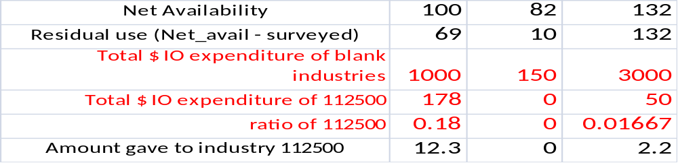
Filling the gaps when there is no survey data – example
After integrating all source data
Benchmark to our control totals
 |  | CC0370 | CC0380 | CC0390
 |  | Coal | Crude oil | Natural gas
111400 | Greenhouse, Nursery and Floriculture Production | 25
111A00 | Crop Production (except Greenhouse, Nursery and Floriculture Production) | 6 | 35
112500 | Animal Aquaculture
112A00 | Animal Production (except Animal Aquaculture)
113000 | Forestry and Logging |  | 25
12.3

Slide 12
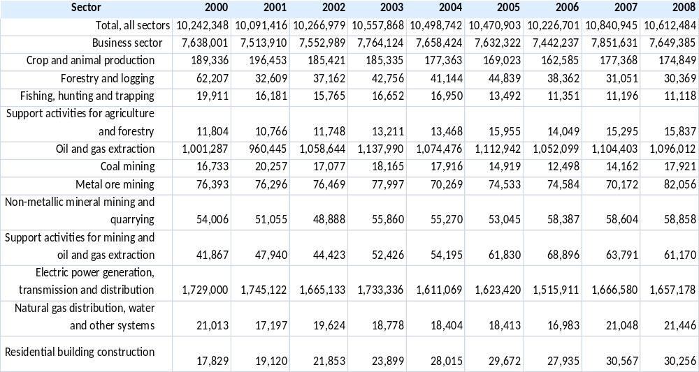
Release format of the Energy Flow Account
Total energy, 1990 - 2008
Industries (117) +
household (2)
Statistics Canada. Table 153-0032 - Energy use, by sector, annual (terajoules), CANSIM (database).

Slide 13
Quality control
% changes in energy use, per industry, per fuel.
Implicit price ($ paid/TJ) and intensity (TJ/$ output), per industry, per fuel.
GHG account output
  Small changes in energy consumption may reflect in high changes in GHG emissions.
Bridge tables
  to explain visually how we go from the total energy consumed to the energy flow account.

Slide 14
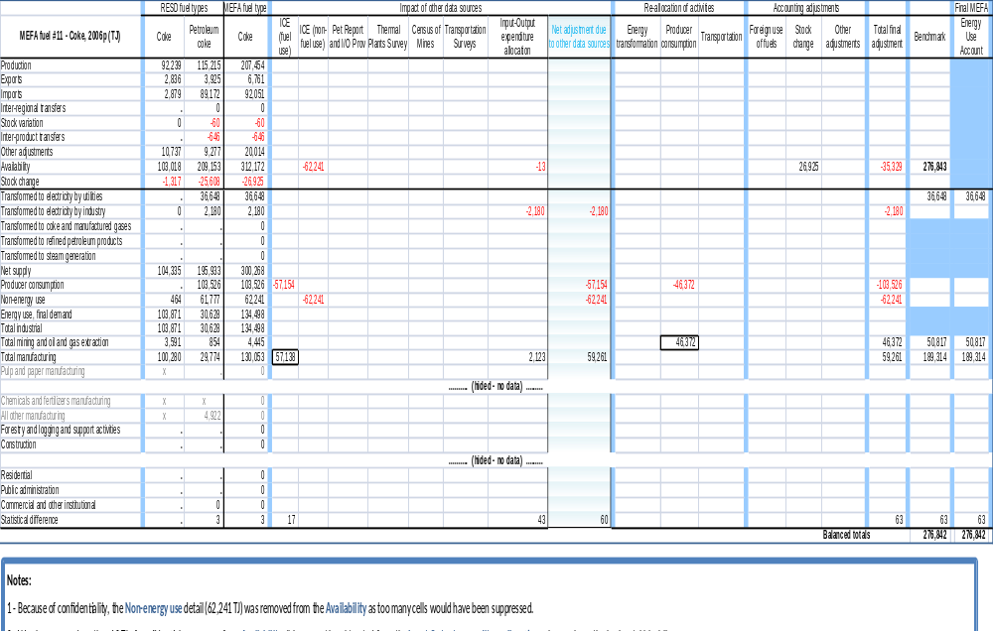
Quality control – bridge table

Slide 15
Challenges
Integration of data from many sources/providers
  Concepts and definitions may be different: be careful of double counting.
    Some data includes foreign purchases of domestic fuel.
    Some data includes producer consumption, some does not.
  Source data are not all collected using the same classification systems.
  Input data are not always in a dataset format.
Need to find new data sources
  Improve household and services sectors (less surveyed).
  Help for decision making when two sources give us different pictures.

Slide 16
Questions?
  Thank you
  For further information:
  Joe St. Lawrence
  Environment Accounts and Statistics Division
  Statistics Canada
  Joe.St.Lawrence@statcan.gc.ca

